Slide 1

Bank Loan Analysis
(Using SQL and Power BI)
By Riya Arora

Slide 2

Objective
This project is to analyze loan data to gain insights into borrower behavior, credit risk, and overall loan performance. By using SQL for data analysis and Power BI for visualization, the project aims to identify key factors influencing loan defaults. It focuses on evaluating different customer segments, loan characteristics, and repayment patterns. The goal is to uncover actionable insights that help reduce default risk and improve profitability. This analysis supports data-driven lending decisions. Ultimately, it helps in building a more efficient and sustainable loan portfolio.

Slide 3
SQL Analysis

Slide 4
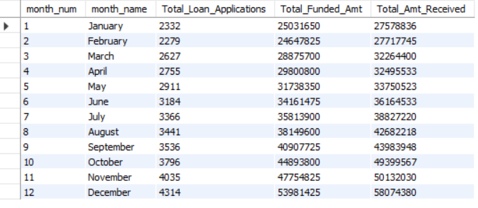
Bank Loan Report Overview
The report provides a high-level view of loan applications, funded amount, and repayments across months.

Slide 5
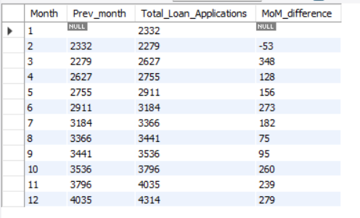
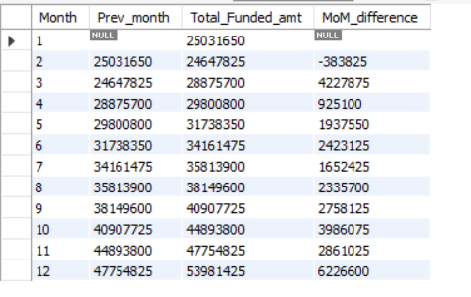
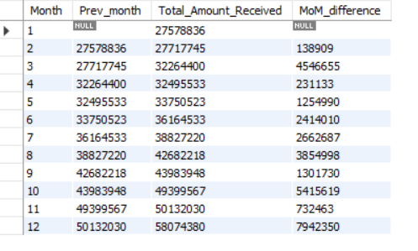
Monthly Performance Trends (MoM Analysis)
Loan applications show an overall increasing trend throughout the year
A slight decline is observed in February, followed by steady growth
Funded amount shows consistent month-over-month growth, especially in later
months
Total amount received also demonstrates a strong upward trend, indicating improving
repayments

Slide 6
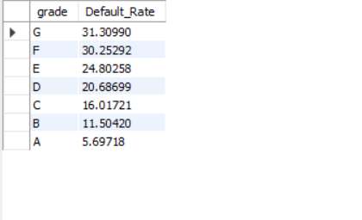
Which loan grade is more risky?
Sub-grades F5 and G-series show very high default
rates (~46%)
Indicates significantly higher credit risk in lower-grade
segments
These borrowers have lower repayment reliability
Highlights need for stricter credit evaluation

Slide 7
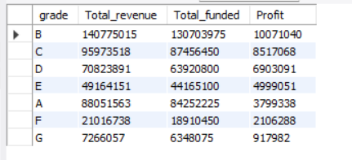
How does profitability vary across different loan grades relative to their risk levels?
Mid-grade loans (B, C, D) generate the highest profits
These segments also have relatively lower default risk
Indicate a strong balance between risk and return

Slide 8
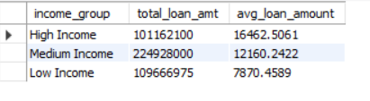
Which income group takes higher loan amounts?
High-income borrowers (>100,000) take larger loan amounts on average
Show greater borrowing capacity compared to medium and low-income groups
Indicate higher financial stability and repayment ability
Suggest banks can safely lend higher amounts to this segment

Slide 9
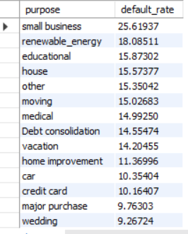
Which loan purpose is most risky?
Small business loans have the highest
default rate (~25.6%)
Followed by renewable energy loans (~18%)
Indicates these categories carry significantly
higher financial risk
Business-related loans show greater
uncertainty in repayment capacity

Slide 10
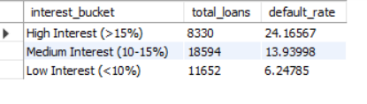
Do loans with higher interest rate have higher default rates?
Loans with high interest rates (>15%) show the highest default rate (~24%)
Compared to:
Medium (10–15%) → ~14%
Low (<10%) → ~6%
Indicates a strong positive relationship between interest rate and default risk
Suggests higher interest is associated with riskier borrowers

Slide 11
Key Insights
Sub-grades F5 & G-series show very high default (~46%), indicating high-risk segments
Mid-grade loans (B–D) provide the best balance of profitability and risk
Lower-grade loans (F–G) are high-risk and low-return
Small business loans have the highest default (~25.6%), indicating risky loan purpose
Loans with higher interest rates (>15%) show higher default (~24%)
60-month loans have significantly higher default risk compared to 36-month
~56.9% of bad loan amount is recovered, indicating partial recovery from defaults

Slide 12
Recommendations
Reduce exposure to lower-grade loans (F & G) due to high default risk and low profitability
Focus on mid-grade segments (B–D) as they offer the best balance of risk and return
Apply stricter credit evaluation for high-risk purposes such as small business and renewable energy
Implement tighter controls for high interest rate loans (>15%), as they are associated with higher defaults
Limit or carefully monitor long-term loans (60 months) due to increased default risk
Closely assess borrowers with high DTI to reduce financial stress-related defaults
Strengthen risk assessment beyond verification, as verification alone does not reduce
default risk
Target high-income and financially stable borrowers for safer lending
opportunities

Slide 13
Dashboard Preview

Slide 14
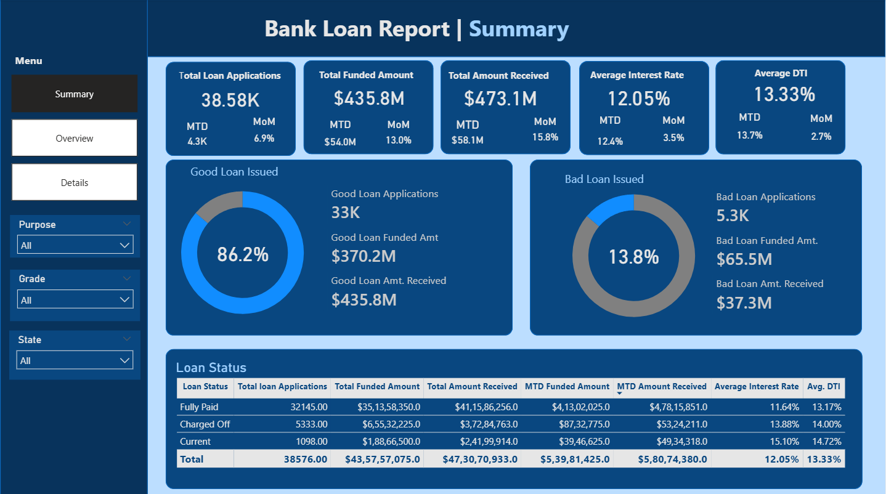
Page 1: Summary

Slide 15
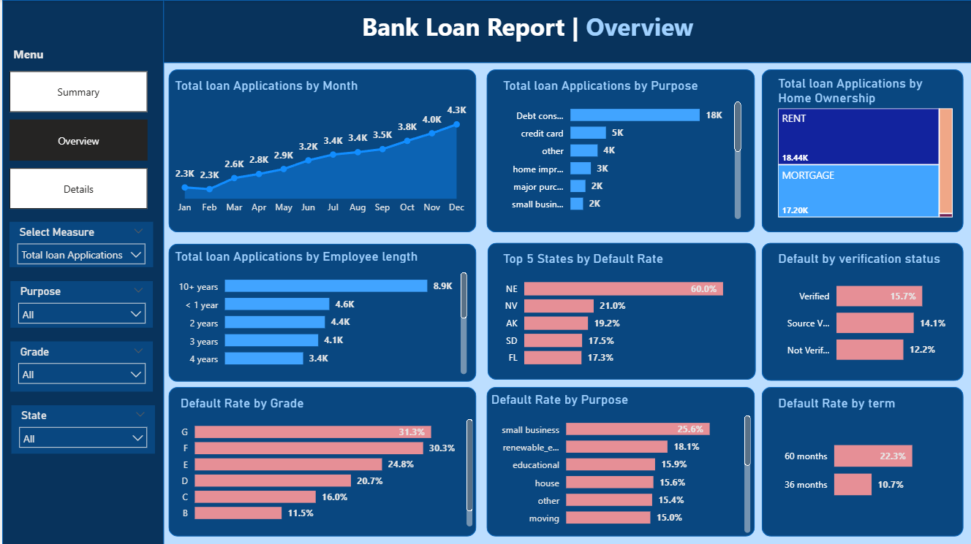
Page – 2 Loan Performance & Risk Analysis

Slide 16
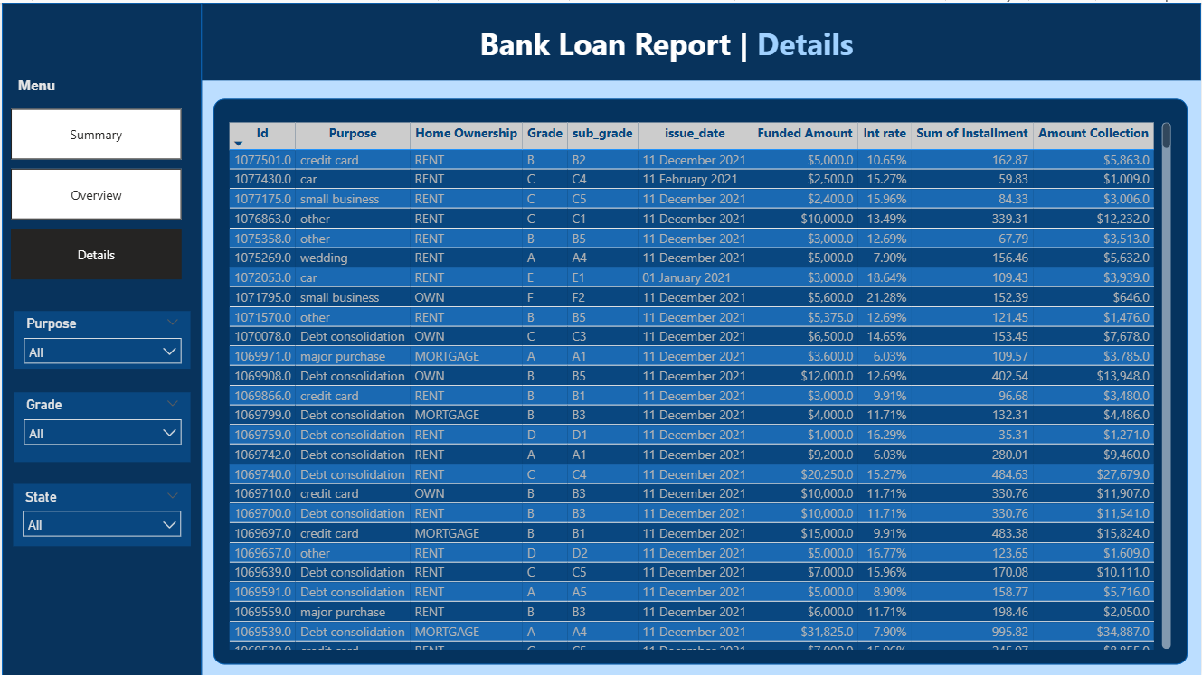
Page – 3 Details

Slide 17
Conclusion
The analysis highlights that loan performance is strongly influenced by factors such as credit grade, loan purpose, interest rate, and loan term. By identifying high-risk segments and profitable customer groups, data-driven insights can help financial institutions improve lending strategies, reduce default risk, and enhance overall portfolio performance.

Slide 18

Thank you !

